Slide 1

a rule-based optimization for genetic circuit design
By Juliette, Electra, Meredith, Trieu, and Rafay
Notes:
RuleScape is a rule-based optimization tool for genetic circuit design.

Slide 2
Goal and Motivation - Rafay
Let’s start with a scenario:
Your PI asks you to make a NOT gate. You know some rules from your personal work, some from other lab members, and you dug some out from lit reviews.
This is the usual flow as you set out on your task
Specify
Design
Build/Test
Learn
By now, we are all well accounted with this flow…
Notes:
Rafay
Let’s start off with a scenario that we can relate to. You’re asked to make a NOT gate for your PI. Through the work you’ve done so far along with some help from lab members and your own literature reviews, you know of some relevant rules or techniques for design that will help with creating an effective circuit that has your desired expression. Of course, we never know that for sure and since you’re using new parts that nobody in your lab has used, you’re kind of in the wild west with what rules and arrangements are going to help. If we were to break it down through the “Specify, Design, Build, Test, and Learn” workflow we’ve been talking about over the semester, we would put these considerations for context effects, part arrangements, etc. under our specify and design steps.

Slide 3

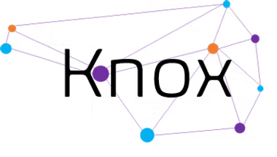
Goal and Motivation - Rafay
How do we connect these seamlessly?
How do we learn throughout this process?
How do we navigate complex rule-spaces and limit combinatorial explosion?
Design
Simulate
Evaluate
Specify
Store
Visualize
You can let RuleScape evaluate which rules are the most important for optimizing the expression of the circuit.
Notes:
Rafay
Diving in a bit deeper, we have a host of tools we could use to help design and specify; Knox and Cello. Naturally this part of the cycle feeds off of each other and we’ll go back and forth between the two as we flesh our ideas out more and decide how exactly we’re going to orient everything. This process is laborious, and there can be a lot of friction going in between the two. Additionally, we’re going to learn more about the new parts we’re using and we will likely want to have some way to document this while we design and specify to help other lab members when they try to use these parts as well. The overall burden and strain on the researcher starts to become a lot, and this is where a lot of people can get frustrated. But what if we had a way to automate all of this? Remove the decision fatigue, get rid of the friction, and give a clear ranked display of designs and rules with high-impact, driving the success of your designs as we work in silico. That’s where RuleScape comes in. RuleScape gets rid of all the fluff and consolidates the whole “design and specify cycle” into one centralized interface, with a ML algorithm trained on experimental data to provide predictions on high throughput designs and rules that drive throughput.

Slide 4
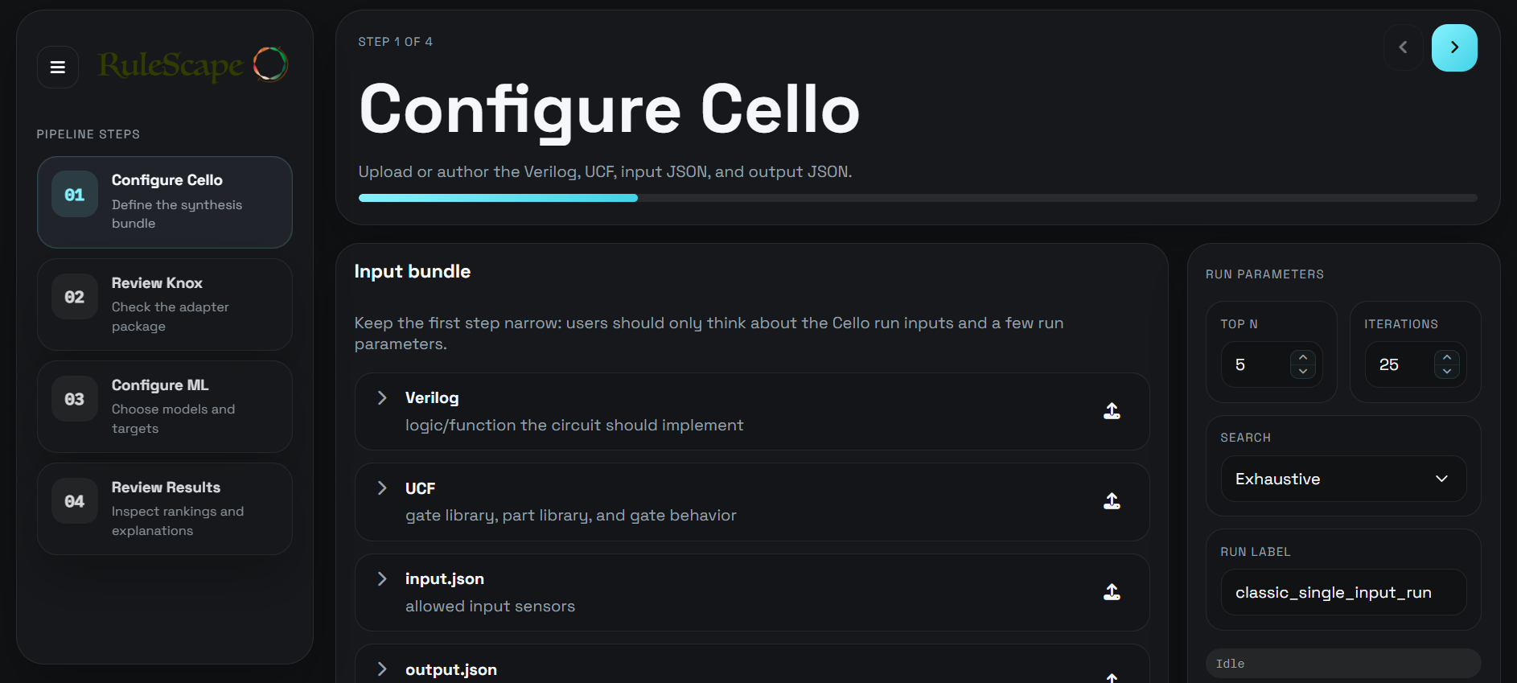
Functionality Overview - Meredith
Develop UCF and CSV files based on data library
Cello runs and outputs expression scores
Knox uses these expression scores and their associated designs and evaluates these rules
ML used to rank these rules based on expression level
Notes:
Meredith - The core functionality of RuleScape is parsing a data library of circuit designs and matching them to rules to rank the rules based on expression levels. The user begins by generating UCF and CSV files from the data library. Cello then runs using the UCF file and outputs expression scores. Knox takes these scores along with their associated designs and evaluates the rules against them. Finally, a machine learning model ranks the rules based on expression levels, giving the user insight into which rules best fit the circuit designs.

Slide 5
Specification Overview - Meredith
Inputs
UCF
Rules
Parts
.mat file
Verilog file
Input file
Output file
All aside from .m must be in .csv for Knox compatibility
Outputs
Ranked Rules
Knox and Cello Outputs
Through performance stats. and rule rankings, users can optimize designs and test
Performance
Node.js + React for GUI
Python for ML + Adapter Layer
Industry standard framework for optimal performance
Requirements
System
System
Scope
Yeast Context
Parts library based on provided data (.mat file)
Fixed circuit length (8 parts)
System
Docker + Local servers
Goldbar syntax for rules
Interoperability between Knox + Cello + RuleScape requires Docker to manage requests between tools
Constraints
Notes:
Meredith - This slide outlines the key requirements and constraints that define the boundaries of RuleScape. Starting with inputs, the system takes in a UCF file, rules, parts, verilog file and a .mat file — with all files aside from the UCF needing to be in CSV format for Knox compatibility.
On the output side, the system produces ranked rules and performance statistics. Through these, users can optimize their designs and test different rule configurations.
For performance, RuleScape uses Node.js and React for the GUI, and Python for the ML and adapter layer — both industry standard frameworks chosen for optimal performance.
In terms of constraints, the scope is limited to yeast context, with the parts library based on the provided .mat data and circuit designs fixed at 8 parts.
On the system side, RuleScape runs on Docker and local servers, with GOLDBAR syntax required for rules. Interoperability between Knox, Cello, and RuleScape requires Docker to manage requests between the tools.

Slide 6
System Diagrams - Meredith
Design.csv
Parts.csv
Rules.csv
Design.csv
Parts.csv
UCF/CSV File Generator
Cello
Knox
ML Algorithm
Real Data Library
Weights.csv
Ranked rules
XGBoost / Random Forest
Verilog file
Input.json
output.json
Notes:
Meredith - This systems diagram illustrates the full workflow of RuleScape. The process begins by inputting the data library into the file generators, which produce the CSV and UCF files. The UCF and verilog files, and input and output json files are then fed into Cello, whose output is used to generate a weights CSV file. Next, the design and part CSV files from the first stage, along with the rules CSV file, are passed into Knox, which outputs a mapping of scores to rules. Finally, the ML algorithm extracts this data and ranks the rules based on the desired expression levels.

Slide 7
CLASSIC Dataset for Cello and Knox - Juliette
CLASSIC Dataset: real experimental data from single-input library
Each row → genetic design corresponding to one particular biological construct built from a specific combination of designs
Each design → 9 design factor column, basal expression, induced expression, fold change and a switch score
Cello Inputs
User-Constraint File: A structured json that tells which gates exist, what model each gate uses, what parts and structures are associated with the gate, the mathematical response function describing the gate behavior
Input, output, verilog
Knox Inputs
Designs
Parts
Rules (user-defined)
Notes:
Juliette
CLASSIC dataset: real experimental data from single-input library
Each row is one genetic design corresponding to one particular biological construct built from a specific combination of design choices
Each design is described by 9 design factor column, basal expression, induced expression, fold change and a computed switch score
User-Constraint File
A structured json that tells which gates exist, what model each gate uses, what parts and structures are associated with the gate, the mathematical response function describing the gate behavior
Knox inputs:
Designs
Parts
Rules (user-defined)

Slide 8
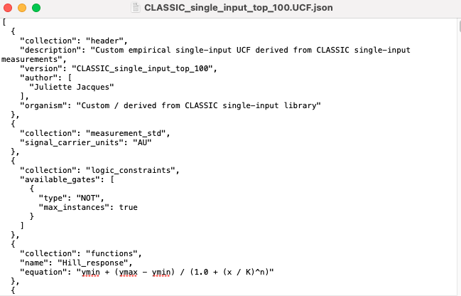
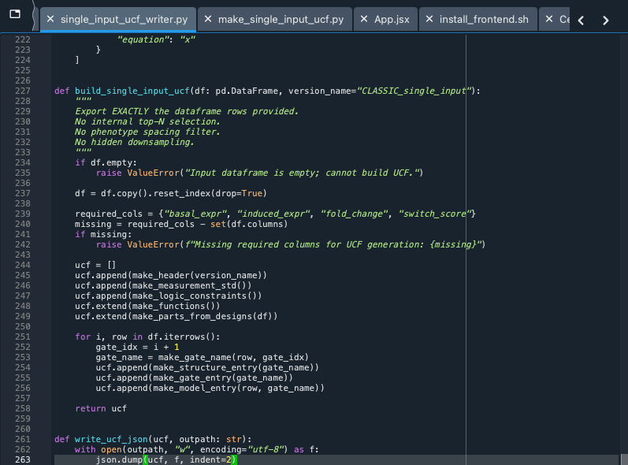
UCF / input / output / verilog files - Juliette
Step 1: Load CLASSIC dataset
Step 2: Compute switch score
Rank designs based on switch strength
Step 3: Clean and structure data for Cello
Choose which rows to export for training dataset (ex: mode=top_100) separated by switch score
Give each exported design a stable identity (CLASSIC_SI_000001) and convert each row to a Cello gate, model and structure (single-input data acts as a NOT gate)
Step 4: Create parts section - unique reusable components
Step 5: Input and output json files with input sensors and output reporters
Stsaaaaaa 6: Verliog → NOT gate for single-input library
Step 7: Inputs to Cello → out of all the gates in this UCF, which one best implements the logical behavior? It outputs a functional score for a selected design
Notes:
Juliette
Includes placeholders - dataset mainly gives behavioral measurements rather than full sequence level parts
Model entry: Hill model (parameters inferred from measured low/high behavior)
y_min => basal expression
y_max => induced expression
K => dynamic range
N => fold-change regime
Structure: how each gate is organized in terms of components (Promoter input, Terminator slots, Reporter unit)

Slide 9
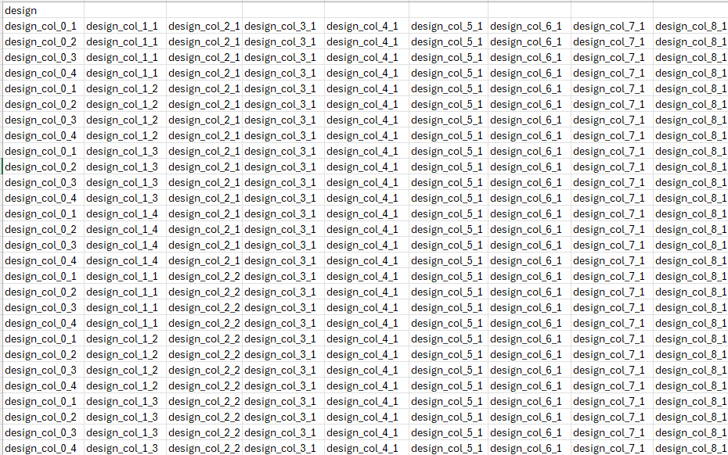
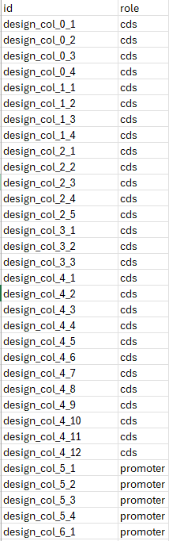
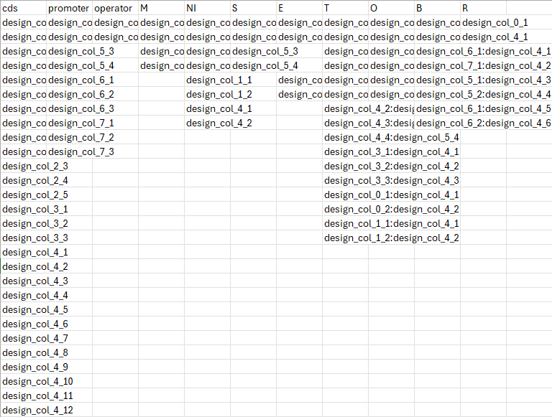
Knox Files - Meredith
Step 1: Load CLASSIC dataset
Step 2: Parse the keys of the .mat file into data frames
Assign_df: Part assignments for each design
Exp_df: Expression measurements
Step 3: Build part library
Maps column prefixes to parts (CDS, Promoter, etc.)
Generates unique part IDs using design_col_{column number}_{component ID)
Outputs part_library
Step 4: Build designs library
Converts each row of assign_df into string of part IDs, separated by commas
Each row represents one design
Step 5: Export to CSV files
part_library.csv
designs.csv
Step 6: Generate a rules .csv file using GOLDBAR
Step 7: Import to Knox
Import part_library, designs, csv to Knox
Cello expression outputs are converted into a .csv file and imported into Knox
Notes:
Meredith - This slide walks through the step-by-step data pipeline that feeds into RuleScape. We start by loading the CLASSIC dataset, then parsing the keys of the .mat file into two data frames — an assignment data frame that tracks part assignments for each design, and an expression data frame that holds the measured expression values.
From there, we build the part library by mapping column prefixes to their corresponding part types, such as CDS and Promoter. Each part is given a unique ID based on its column number and component ID, and the result is exported as the part library.
Next, we build the designs library by converting each row of the assignment data frame into a comma-separated string of part IDs, where each row represents one complete circuit design.
Both the part library and designs library are then exported as CSV files — part_library.csv and designs.csv — which serve as inputs for the next stage.
A rules CSV file is then generated using GOLDBAR, defining the rule set that will be evaluated against the designs.
Finally, everything is imported into Knox — the part library, designs, and rules CSV files. In parallel, the expression outputs from Cello are converted into a CSV file and also imported into Knox, setting up the scoring and ranking stage.

Slide 10
ML Pipeline - Electra
Inputs
Knox Exctraction
ML Pipeline
GUI Rendering
KnoxStage:
DesignID
GroupID
EvalName
Connects to Knox API
Formats dataframe for ML
Receives Response JSON
Fast API
Receives and Validates ML request
Splits test/train data
Retrieves designtorule_df
Displays in UI:
Model name
Accuracy
Top Rules
Calls and runs ML model scripts
User:
Models
Train split
Top N Rules
Initiates ML Pipeline
Returns model summary
Notes:
Electra -
After generating designs scores in Cello and performing the rule evaluation in Knox, the ML pipeline in Python is used to identify top contributing rules to model performance.
At the start, within the GUI the user specifies what ML models to run, the test/train split, and the top contributing N number of rules to return. When the click runML, the workflow takes in these user parameters along with the parameters EvalName, DesignID, and GroupID from the Knox rule evaluation. These inputs are packages into a JSON and sent to a FASST API backend that validates the inputs and passes them into the python environment.
The next step in the pipeline is using these parameters to call the Knox API and retrieve the design-to-rule dataframe, is provides a binary matrix of whether each rule is followed ine each design. This is passed into the ML pipeline.
Within the ML pipeline, the design-to-rule dataframe is transformed for ML analysis including performance scores (from Cello), and labels (good or bad for binary classification). Then the dataset is split into testing and training sets, and each model selected by the user is trained, evaluated, and used to extract top contributing N rules. The models available through RuleScape include XGboost, binary decision tree, regression decision tree, and random forest.
The model results are aggregated afterwards into a JSON response that is rendered within the GUI. The overall output for the user is each model’s name, its corresponding accuracy, and a list of the top N features and their corresponding contribution scores.
Bullet Notes
Inputs:
User inputs:
Selects models to run
Sets parameters for train/test split, and number of top contributing rules to return
Clicks RunML
KnoxStage inputs:
DesignID
GroupID
EvalName
Fast API - when “RunML” button is clicked
A post request is sent to the ML fast API in JSON format containing user parameters from mlStage and KnoxStage (prior)
Ml_server.py receives request
Ml_routes.py validates json and calls the model pipeline
Knox Extraction
runner.py -
Calls the Knox API to get the designtorule_df from the rule evaluation
Feeds designtorule_df and user selected parameters into the ML model pipeline
ML Pipeline:
pipeline.py
Extracts the binary rules matrix, y_labels, y_scores, and feature_names from the designstorule_df
Splits data into testing and traininsetss
Calls and runs scripts for all user selected models
Returns results from models
Accuracy
Top N contributing features and their corresponding importance scores
Model summary including
The model type
Model Parameters
max_depth
Feature_count
Model Scripts
Take in the training and testing data, top rules to keep, and feature names from dataset
Train model with training data
Test model with testing data
Calculate accuracy of testing prediction
Extract top contributing rules
Return results to the pipeline.
GUI Rendering - outputs
Recieves a JSON of the results that is parsed and formatted revealing to the user, the model type ran and its corresponding parameters, accuracy, and list of top contributing rules and performance scores.

Slide 11
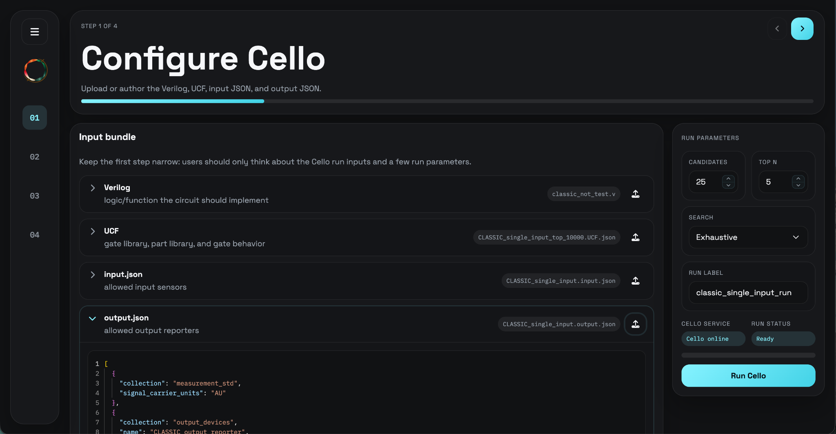
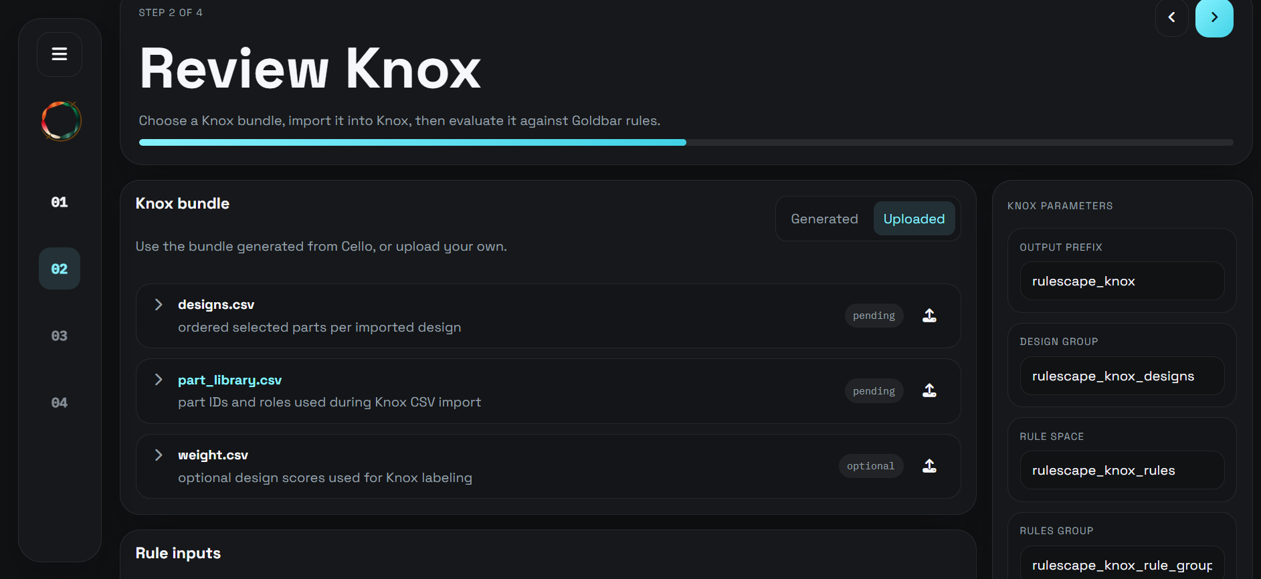
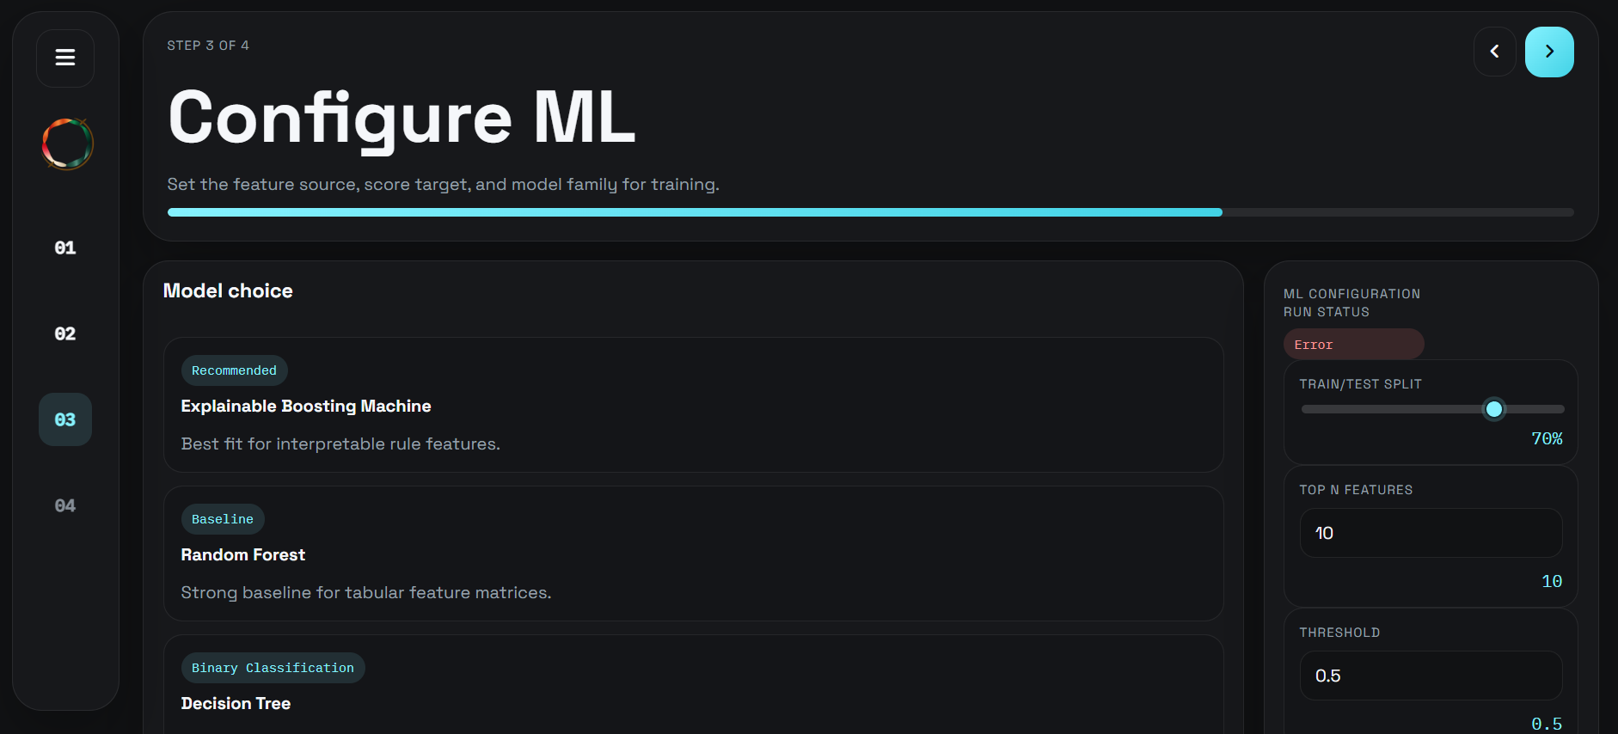
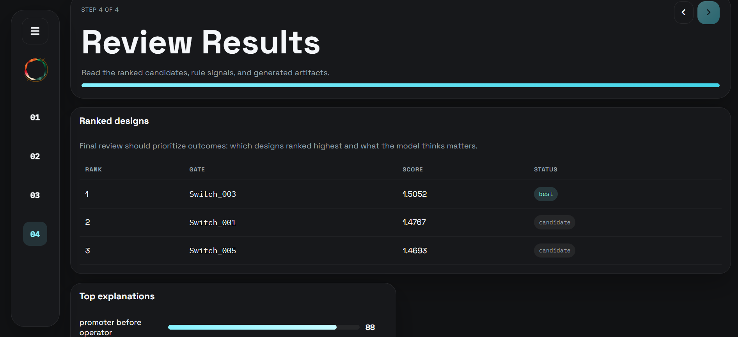
GUI - Trieu
Notes:
Now let's walk through the RuleScape graphical interface and how it guides the user through the full pipeline.
The app is structured as a 4-step linear pipeline designed for synthetic biology circuit design and rule evaluation. On the left side of the screen, you'll see a collapsible navigation sidebar showing the four steps numbered 01 through 04, with visual indicators for which step is active, complete, or upcoming. The main area displays the current step's content in a two-column layout — the stage view on the left and a run panel on the right where you configure parameters and trigger each stage.
Step 1 — Configure Cello. The user starts by uploading or authoring four files: a Verilog file, a UCF file, and input and output JSON files. On the run panel, the user sets parameters like candidate count, top N, and search algorithm — either Exhaustive or Annealing. Clicking Run Cello sends these files to the Cello pipeline API, which returns generated CSV files and ranked candidates that carry forward into the next step.
Step 2 — Review Knox. This stage has two sequential sub-tasks. First, the user imports a bundle — either using the CSV files generated by Cello, or uploading their own designs, part library, and optional weights file. Once the import succeeds, the second sub-task unlocks: the user provides a GOLDBAR rule expression and a categories file, then clicks Evaluate Rules. The results show a design-by-design rule pass/fail breakdown with a color-coded visualization of each part sequence.
Step 3 — Configure ML. Here the user sets the train/test split using a slider, selects the top N features, and sets a score threshold. Clicking Run ML sends this configuration to the local ML server, which processes the Knox results and prepares the final rankings.
Step 4 — Review Results. The final stage displays the ranked candidates, rule signals, and all generated artifacts from the previous steps, giving the user a complete picture of which circuit designs best satisfy the specified rules.
One important feature running throughout the entire pipeline is service health monitoring. The app checks the Cello and Knox backend services every 5 seconds. If either service goes offline, the corresponding run button is automatically disabled and a status indicator updates in real time — so the user always knows whether the system is ready to run.
To summarize the data flow: user inputs feed into Cello, whose outputs flow into Knox for rule evaluation, which then feeds the ML stage for final ranking. All intermediate results are held in the app's top-level state and passed forward through the pipeline automatically.

Slide 12
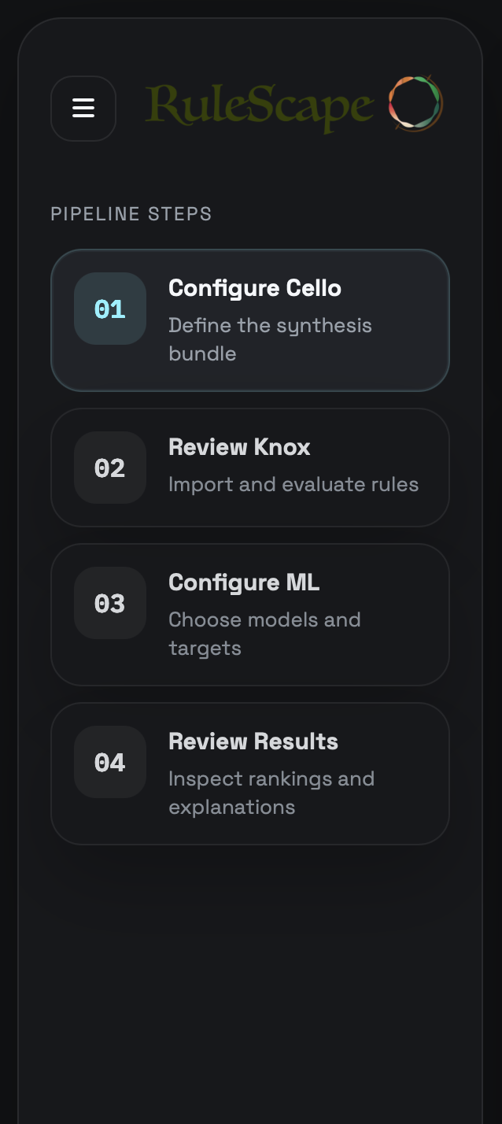
Example Interface: Video - Trieu
Click for User Interface Demo Video
Notes:
Trieu

Slide 13
Limitations - Juliette
Trained model only works well if new datasets are in a similar design space
1
Different parts
A separate UCF and designs, parts and rules inputs would need to be made and input to cello and knox.
2
Different architecture
The ML Model only is trained for the specific datasets used.
3
Different biological system
An improvement for future work would be to automate UCF and rule generation for the future.
Script generating UCF and CSV files are dataframe structure dependent
Notes:
Juliette
Trained model only works well if new datasets are in a similar design space
Same types of parts
Same architecture
Same biological system
Script generating UCF and CSV files are dataframe structure dependent
Naming conventions for each sheet in dataframe
How each part is represented
Size of design

Slide 14
Successes
Failures
Electra
Organization
Successfully generated a UCF file and designs from real data
Keeping on track with our timeline and finalizing project plans
Shifting directions while maintaining alignment
Created an automated pipeline within GUI: Cello->Knox->ML->Rule Ranking
Deliverables
Scaling with larger and multiple datasets
ML Model Variety
Distribution of work among team
Automated UCF generation for any dataset
Notes:
Electra -
For our project, we overall met our goal and delivered a complete project. Many of our success align with our project tasks and goals.
SUCCESSES
A major challenge and win was the successful generation of UCF files and designs from a real dataset, which was necessary to predict design performances. We also successfully completed our overarching project of creating an automated pipeline fully accessible through out GUI that run from design performance prediction in Cello to rule evaluation in Knox to machine learning used to identify top contributing rules in given designs.
All team members were also actively involved and work was well distributed across team members within this project according to capabilities, interest and time.
FAILURES/CHALLENGES
Despite our success, there were some times the project did not work out as planned in terms of our team organization and more ambitious deliverables
Regarding team organization, we did not keep up with our timeline well, especially as many of use have other jobs and commitments, resulting in great risk as the deadline approached. This was further compouinded by our group considering different angles for our project and shifting directions, which was not always communicated well across the group causing misalignment and confusion at times. We definitely should’ve spent more time concretely defining our project and regularly discussion work with each other
Regarding deliverables, there were some initial project hopes never realized due to feasibility and time constraints. One would be amazing goal was to automate the creation of UCFs for any dataset, but this was challenging due to lack of available biological data and the complex architecture UCF the file. We also had issues with scaling the creation of designs with the UCF and running very large datasets in the pipeline due to the complexity. Finally, we had hoped to implement a border array of ML models beyond tree-based.
The combination of our individual work was also a major bottleneck, and we failed to realize how difficult GUI integration is, and struggled understand the inputs, specfiications, and outputs of other members parts.
Overall, we should have made more efforts ahead of time in the project to clearly defined its scope and scale back on some of the ambition or complete more prerequisite research first. We found it was easy to have grand ideas that are difficult or unfeasible to implement.

Slide 15
Conclusion - Meredith
RuleScape successfully connects Cello to Knox and ranks rules based on expression scores.
Future Work:
LLM for data parsing - automate input formatting
LLM for rule generation - automate GOLDBAR rules
More ML models - improve analysis
More data - improve training
Wet lab validation - real world confirmation
Notes:
Meredith - To wrap up, RuleScape successfully achieves its core goal — connecting Cello and Knox into a unified pipeline that ranks rules based on expression scores, giving synthetic biologists a streamlined tool for circuit design evaluation.
Looking ahead, there are several exciting directions for future development. First, we'd like to integrate a large language model for data parsing, which would automate the input formatting process and reduce the manual effort required to prepare files for the pipeline. Similarly, an LLM could be used for rule generation, automatically producing valid GOLDBAR rules from higher-level user descriptions rather than requiring users to write them by hand.
On the machine learning side, incorporating additional models beyond the current decision tree approach would improve the depth and accuracy of the analysis. Expanding the dataset used for training would also strengthen the model's ability to generalize across a wider range of circuit designs.
Finally, and perhaps most importantly, wet lab validation would ground RuleScape's results in real-world confirmation — verifying that the rules and rankings the system produces actually hold up in a physical biology setting.
Together, these improvements would move RuleScape from a functional prototype toward a fully automated, validated tool for synthetic biology research.

